Slide 1


Slide 2
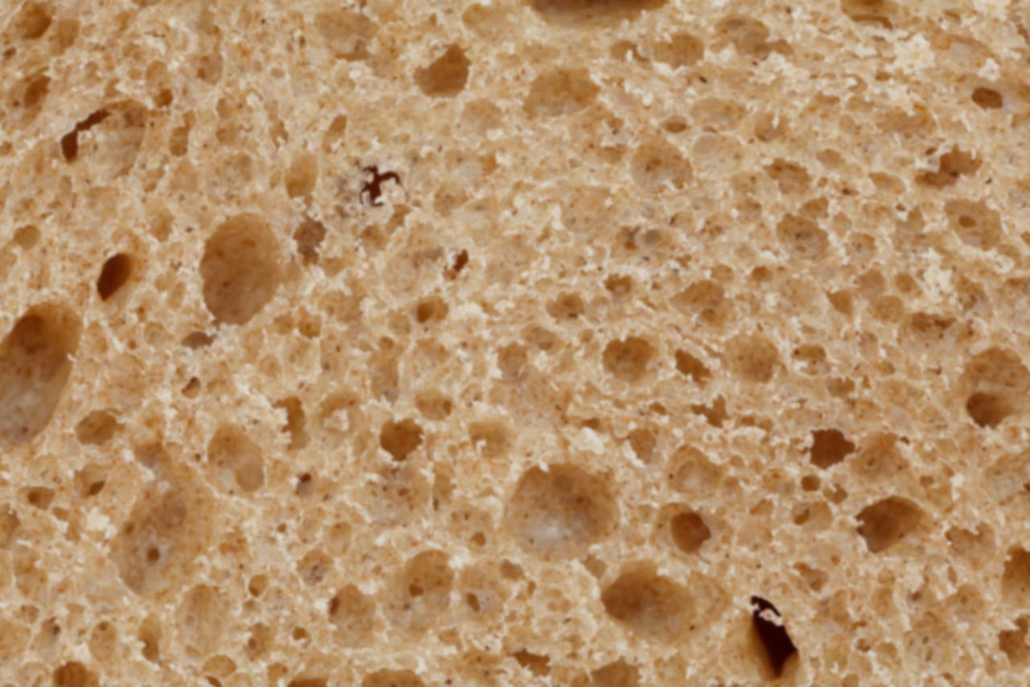

Introducing
App
2
Eat

Slide 3


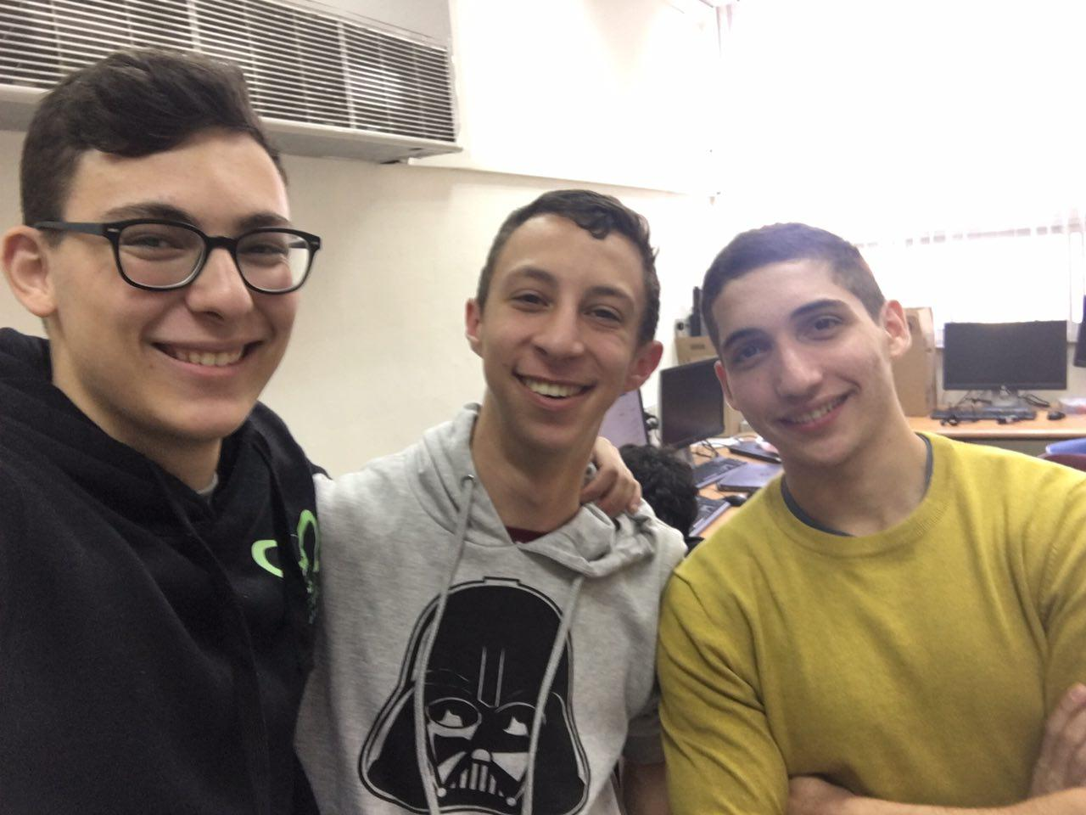
Who are we?
Hi! We are Raz, Itay and Dan, winners of the 2016 Ohel-Shem Hackathon™.

Slide 4
The problem
Unfriendly apps for ordering food
Clumsy user interface
No option for price ranging

Slide 5
The solution?
Notes:
אחרי זה מדגימים את האפליקציה

Slide 6
Skills learned:
HTML, CSS, JavaScript
PHP
Jquery, SQL
Database management

Slide 7

Friendships made:
A lot

